Slide 1

Complex Pricing
Professor Nico Voigtländer
Management 405: Module 6

Slide 2
announcements
Practice Final Exam now Online
  Similar to actual final
Final exam: You will have 5 hours
We’ll have 2 windows with guaranteed TA availability on Zoom
  Saturday, March 19: 9am-2pm
  Sunday, March 20: 9am-2pm
Remember: Many practice problems on Achieve!

Slide 3
agenda for the class
1. The Economic Way of Thinking
2. Value and Demand
3. Supply and Cost
4. Markets, Pricing and Strategy

Slide 4
OUTLINE of module 6
Simple vs. complex pricing
Direct price discrimination
  Perfect price discrimination (first degree)
  Segment pricing (third degree)
Indirect price discrimination (second degree)
  Versioning
  Coupons
Advanced pricing strategies
  Flat fee pricing
  Two-part tariff
  Block pricing

Slide 5
OUTLINE of module 6
Simple vs. complex pricing
Direct price discrimination
  Perfect price discrimination (first degree)
  Segment pricing (third degree)
Indirect price discrimination (second degree)
  Versioning
  Coupons
Advanced pricing strategies
  Flat fee pricing
  Two-part tariff
  Block pricing

Slide 6
Dilemma of simple pricing
Simple pricing: same price for all customers
Limitations of simple pricing:
  If you charge a high price, you prevent customers with relatively low willingness to pay (marginal personal value) from purchasing your product
  If you charge a low price, you are too “generous” to those with high willingness to pay

Slide 7
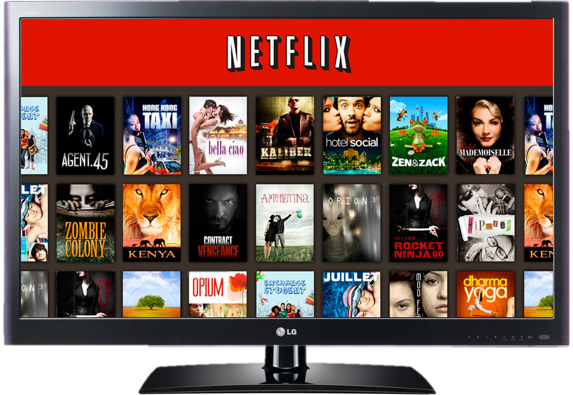
What if Netflix used Simple pricing per movie? (assume MC=0)
P
$2
P=2-Q/8
Since MC = 0, profit max.
implies: MR=MC=0
Under simple pricing, Netflix
would charge $1 per movie
$1
Max. TR
=$8
D
MC=0
8
16
Movies
MR
Notes:
When an individual can buy several units of an item, the seller can think about a advanced pricing strategies. This is the case of continuous choice as opposed to binary choice (buy/don’t buy). Diminishing marginal personal value comes into play – the value of each subsequent unit falls.

Slide 8
Simple pricing:
Netflix would ‘lose’ Revenues
P
P=2-Q/8
Simplifying assumption: MC=0
“Wasted profits”: consumer surplus + unexploited markets
Can do better using complex pricing
Consumer Surplus
Revenues
$2
Unexploited Markets
8
16
Q
Notes:
Ask in class if this is a price searcher or price taker
The dilemma of pricing is that if you charge a high price to capture a lot of value, you exclude many from wanting to buy the product, namely the hordes of those with valuations for the product that are lower than price. The alternative is to go with volume, but then you have to charge a low price and you give away a lot of consumer surplus, leave a lot of surplus on the table which you do not capture. There is a dilemma. Today we will see how to escape the dilemma through price discrimination.

Slide 9
Complex (non-uniform) pricing
Requirements for complex pricing:
Market power
  Downward-sloping demand (i.e., price searcher)
    So far, we studied simple pricing of price searchers
    Now: Complex pricing
Capacity to prevent resale and arbitrage
  Enables sellers to charge different prices for different volumes/packages, or to different customers
Complex pricing is usually more profitable than simple pricing.
Notes:
Consumers are better off under resale: low-price consumers can resell their purchases at a profit; high-price consumers can buy product at a lower price than the firm would charge
Firms are not better off, since only selling at one price, the lower price!

Slide 10
Three degrees of price discrimination
First degree (direct):
  “Dream world”: firm knows each customer’s willingness to pay (marginal personal value – MPV)
Third degree (direct):
  Firm can identify specific groups of customers with different MPV (students, seniors, tourists)
Second degree (“indirect”):
  Firm cannot directly identify the different customers’ MPV. Instead, the firm uses different purchase options to infer willingness to pay: versioning, quantity discounts, coupons

Slide 11
OUTLINE of module 6
Simple vs. complex pricing
Direct price discrimination
  Perfect price discrimination (first degree)
  Segment pricing (third degree)
Indirect price discrimination (second degree)
  Versioning
  Coupons
Advanced pricing strategies
  Flat fee pricing
  Two-part tariff
  Block pricing

Slide 12
First degree price discrimination
Charge each customer a different price
Also known as perfect price discrimination
Conditions:
  Many consumers with different MPV for the firm’s product
  Firm knows each consumer’s MPV (i.e., willingness to pay)
  Firm can prevent resale
Note: This is (still) a hypothetical scenario!

Slide 13
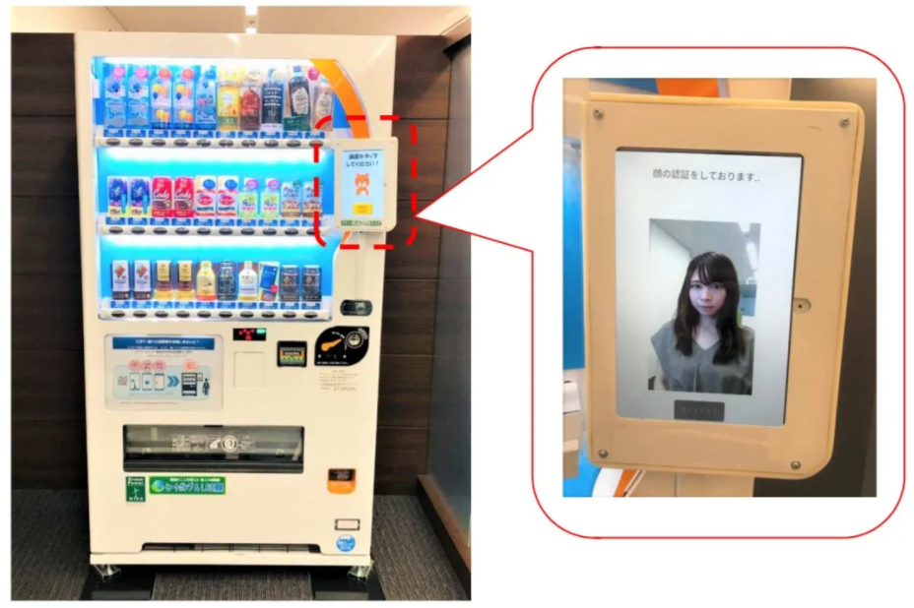
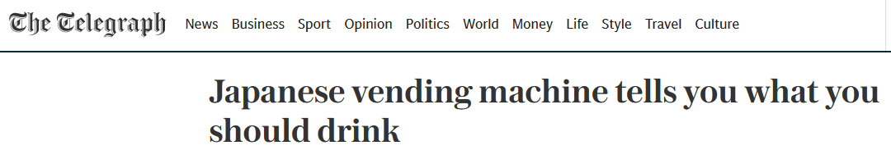
The Dystopian Future of Price Discrimination
Why are companies increasingly able to use first-degree price discrimination (personally tailored prices)? Any examples?
Is the trend towards more price discrimination good or bad for consumers?

Slide 14
First degree price discrimination
Price / MPV
Assume MC=0
Charge each customer a different price
The Holy Grail of complex pricing
Zero consumer surplus: everything is extracted!
Price charged to
high-MPV customer
Price charged to
median-MPV customer
Revenues and Profits
(assume MC=0)
Price charged to
low-MPV customer
Demand = MPV
Notes:
In an ideal world you would like to charge individual prices to mop up all the surplus – to capture all the area beneath the Demand curve in the form of corporate revenue. This type of customized pricing represents the ideal. Customized to what? To the buyers’ valuations! This is difficult to do in practice for a variety of reasons: e.g., arbitrage, legal restrictions.

Slide 15
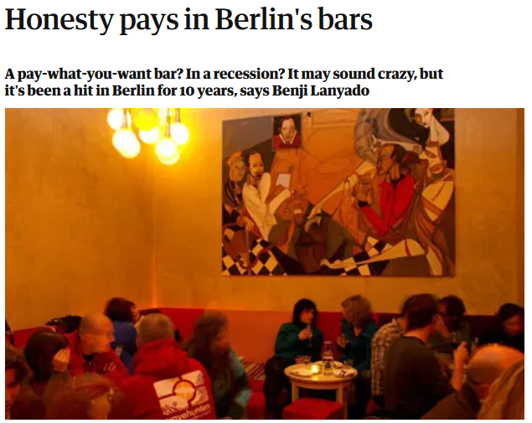

First degree price discrimination
Price / MPV
Now: MC>0
Can it work in the real world?
Price charged to
high-MPV customer
Price charged to
median-MPV customer
Profits (if TFC=0)
Do not sell to low-MPV customer
MC
Demand = MPV
Notes:
In an ideal world you would like to charge individual prices to mop up all the surplus – to capture all the area beneath the Demand curve in the form of corporate revenue. This type of customized pricing represents the ideal. Customized to what? To the buyers’ valuations! This is difficult to do in practice for a variety of reasons: e.g., arbitrage, legal restrictions.

Slide 16
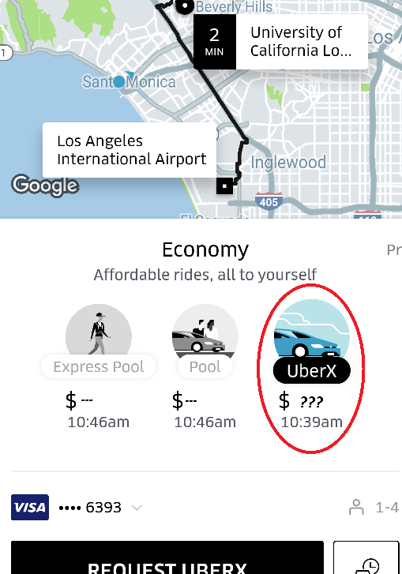
Uber Starts Charging What
You’re Willing to Pay?
I need 10 volunteers (5 for Uber, 5 for Lyft).
Open your Uber/Lyft app.
Enter “LAX” in the destination address.
Do NOT hit request.
Just tell me the UberX/Lyft price.

Slide 17
OUTLINE of module 6
Simple vs. complex pricing
Direct price discrimination
  Perfect price discrimination (first degree)
  Segment pricing (third degree)
Indirect price discrimination (second degree)
  Versioning
  Coupons
Advanced pricing strategies
  Flat fee pricing
  Two-part tariff
  Block pricing

Slide 18

Third degree price discrimination: segment pricing (group pricing)
Divide customers into different groups with different price sensitivities, and charge each group different prices
Conditions:
  Consumer groups with (on average) different MPV
  Firm can identify these groups
  Firm has market power and can prevent resale

Slide 19
SEGMENT PRicing
Price
  Divide customers into different groups with different price sensitivities
  Charge each group different prices (lower prices to more elastic groups)
P₁
Regular
movie-goers
P₂
Seniors
Demand
Notes:
We reintroduce segment pricing, a concept already introduced in week 2 when we discussed Mercedes’s optimal pricing in the US and Germany, based on different elasticities.
At the car wash, senior citizens get a discount. This is price discrimination based on age. Why do firms select different prices for different segments? We talked about incentives to discriminate when different market segments exhibit different demand elasticities. You want to equate marginal revenue across segments, assuming marginal cost is equal across segments. The implication of this is that you want to charge a lower price for the more elastic segment.
So why are senior citizens more price sensitive?
Going to the car wash is a time consuming activity. It can take 40 minutes, sometimes more for an upscale treatment. Senior citizens can afford to drive around longer for a better deal. Opportunity cost of time. They have lower income, so they are more price sensitive The opportunity cost of time for a senior person is much lower than say for a professional. A professional is concerned about the value of time. Senior citizens don’t care so much about the time component of the cost of the car wash, so they are more sensitive to price.

Slide 20

Segment pricing: student discounts
Notes:
Why would you charge lower price to students? lower incomes and more free time. As a result, they are more price-elastic and it is optimal to offer them discounts.
Important: you need to “verify” that they are indeed students.

Slide 21
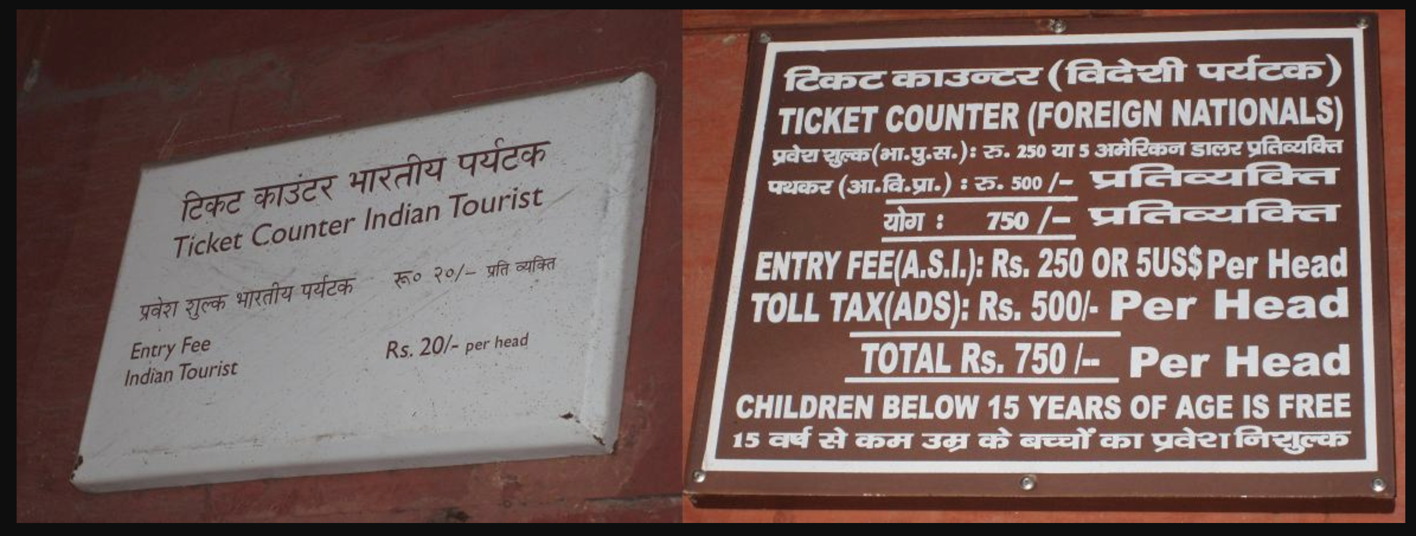
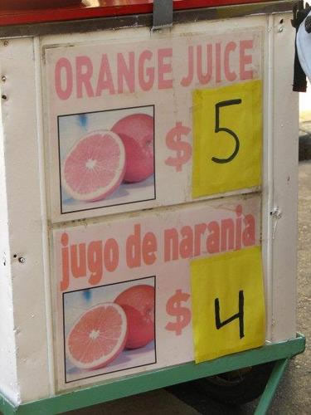
Segment pricing: discounts for locals
Notes:
Disneyland and Taj Mahal: lower prices for Socal/Indian residents compared to tourists. Why? Tourists have lower elasticity of demand than locals that have more easily available alternatives (and in the Indian case, lower income). Generalized phenomenon in tourism – in India airlines used to charge higher fares to tourists.
Another Example: US drugs cheaper in Canada than in USA. There is more discretion as to price in the US because there is less collective bargaining between public entities and pharmaceutical companies for lower prices. This creates incentives for transshipping of drugs – parallel imports to take advantage of arbitrage opportunities.

Slide 22
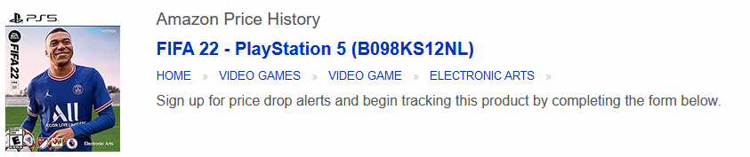
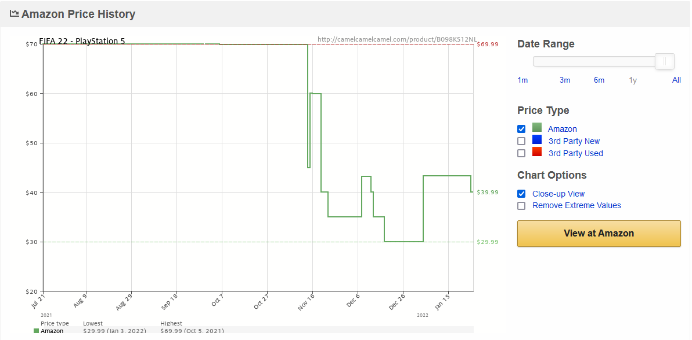
Segment Pricing: Timing
Source: https://camelcamelcamel.com/
Notes:
One can go directly to the website and look for favorite goods. I use coffee moka bialetti:
https://camelcamelcamel.com/

Slide 23
segment pricing: ways to segment consumers
By customer characteristics
  Age, gender,…
  But even by ‘customer’ species: Doctors and veterinarians sometimes use the same medicines.
Discounts for new customers (gym memberships)
By location
  Pharmaceuticals in US v. emerging economies
Intertemporal
  Electronic gadgets: Early adopters vs. Mass market
  Pricing based on search history
  Black Friday
Notes:
For next slide: the price of Lodine for humans is three times the price for animals

Slide 24
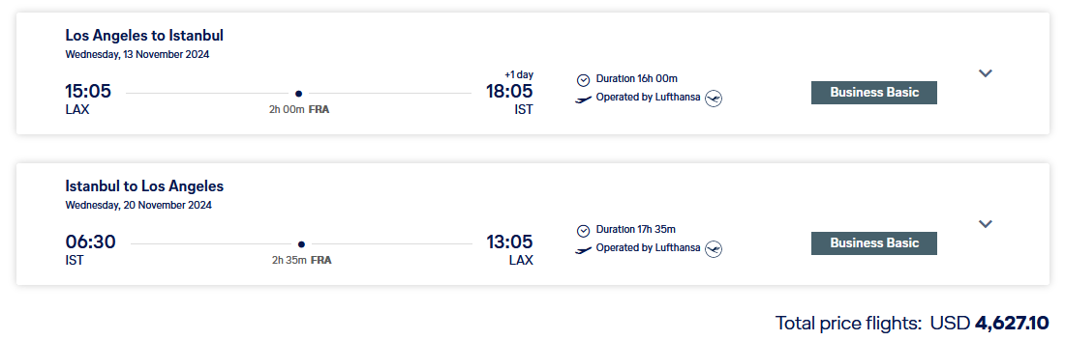
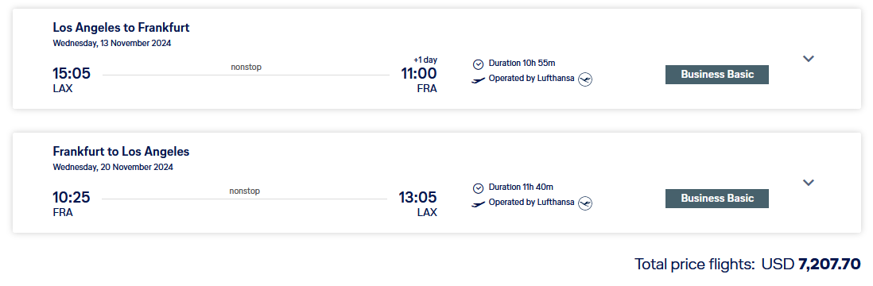
Airline Pricing: We can now Solve thE ‘Puzzle’ from Week 1:

Slide 25


Lufthansa Pricing: Solution
Flight LAX - IST via FRA
Direct Flight LAX - FRA
P
P
P*
Higher price for shorter direct flight
P*
MC
MC
$$MR=MC$$
D
$$MR=MC$$
D
Q*
Q
Q*
Q
MR
MR

Slide 26

Consumer Segments in Medication
Lodine, a medication for arthritis, is used for both humans and dogs.
Which segment 'pays' a higher price?
Poll Everywhere Break
Notes:
For next slide: the price of Lodine for humans is three times the price for animals

Slide 27
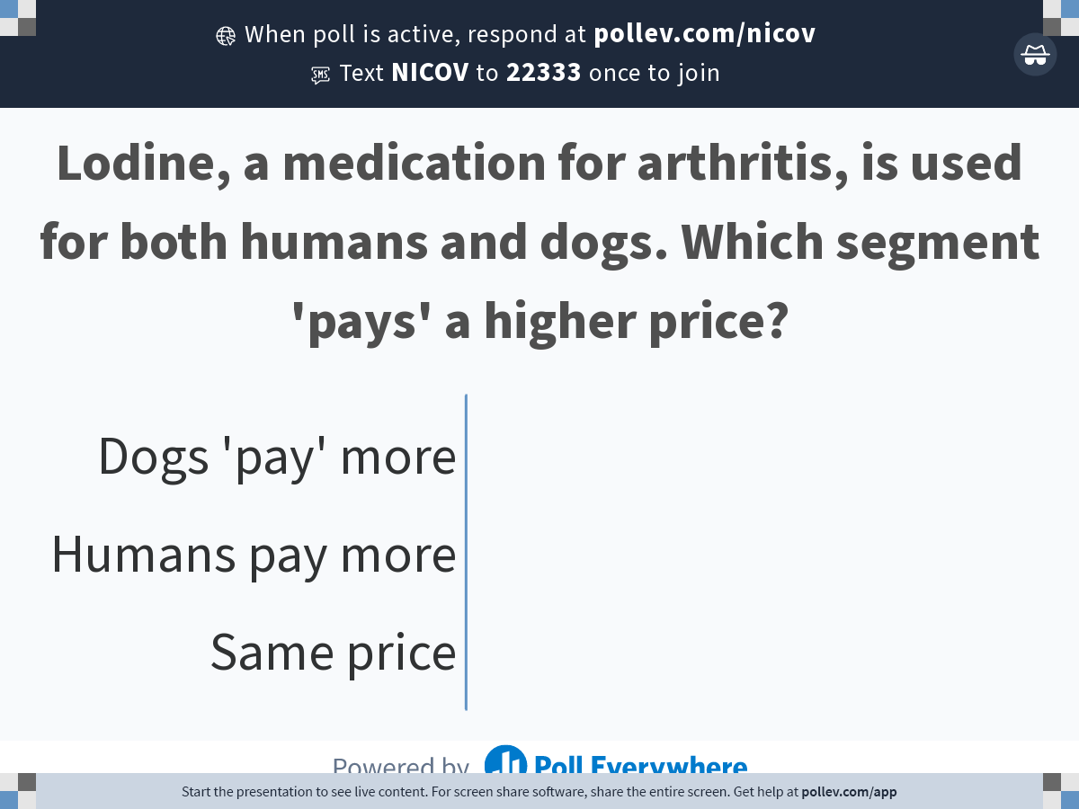
Notes:
Poll Title: Do not modify the notes in this section to avoid tampering with the Poll Everywhere activity.
More info at polleverywhere.com/support
Lodine, a medication for arthritis, is used for both humans and dogs. Which segment 'pays' a higher price?
https://www.polleverywhere.com/multiple_choice_polls/4BC5CeS5GrXrPVaYNwliJ?state=opened&flow=Default&onscreen=persist

Slide 28
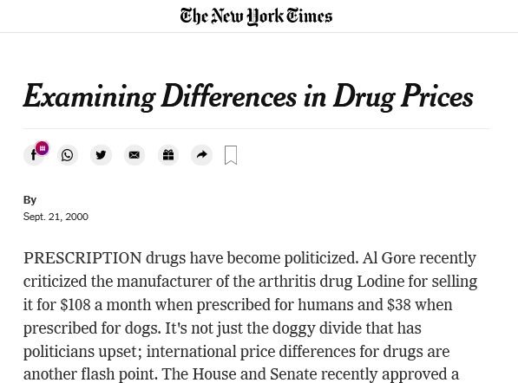
Solution
Higher price for humans!
Poll Everywhere Break
Notes:
For next slide: the price of Lodine for humans is three times the price for animals

Slide 29
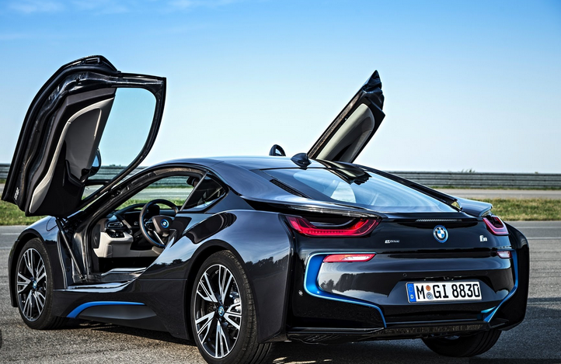
Important: Segment Pricing Analytically
A firm produces the same product for two markets
Math:
Set MR_{i}=MC_{i} in each market i
Practice Video!
Optimal Pricing in two Markets
  Prices different if demand (MR) and/or costs (MC) are different
  Rule: Charge lower price in more elastic markets

Slide 30
Challenges with segment pricing for BMW
Suppose BMW sets very different prices in Germany vs. U.S.
Do you anticipate any problems?
  Arbitrage: re-importation from the cheaper market
    Difficult in this particular case (e.g., miles vs kilometers; taxation).
    However, easier in other cases (e.g., buying textbooks in India and reselling them in the US)
  Consumer backlash

Slide 31
OUTLINE of module 6
Simple vs. complex pricing
Direct price discrimination
  Perfect price discrimination (first degree)
  Segment pricing (third degree)
Indirect price discrimination (second degree)
    Versioning
  Coupons
Advanced pricing strategies
  Flat fee pricing
  Two-part tariff
  Block pricing

Slide 32
Second degree price discrimination:
Versioning
Indirect price discrimination
Charge different price for different versions of the product
Conditions:
  Firm has market power
  Consumer groups with different willingness to pay for the product category (e.g., flights)
  Firm cannot identify the different groups of consumers

Slide 33
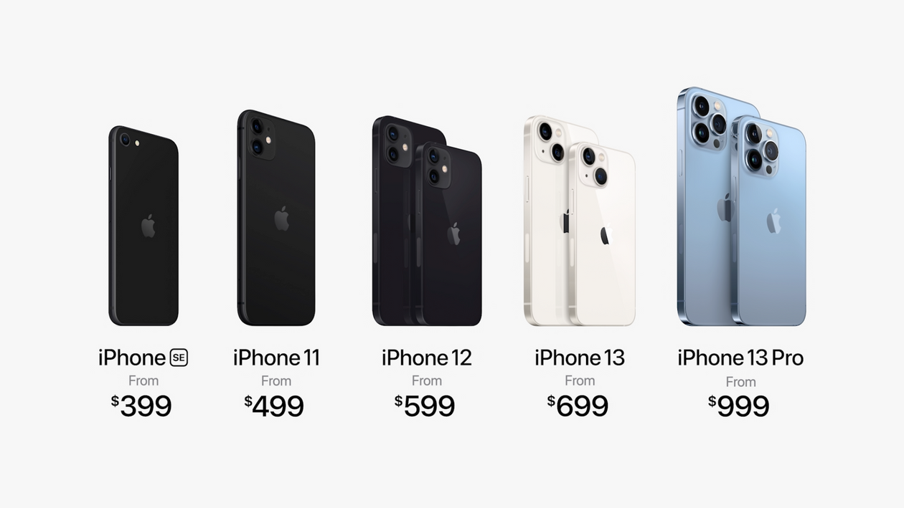
VErsioning
P/MPV
  Create different “versions” of your product
  Design them such that customers with different MPV “self-select” into the desired version
Version 1
P₁
Version 2
P₂
Version 3
P₃
Version 4
P₄
Version 5
P₅
demand

Slide 34
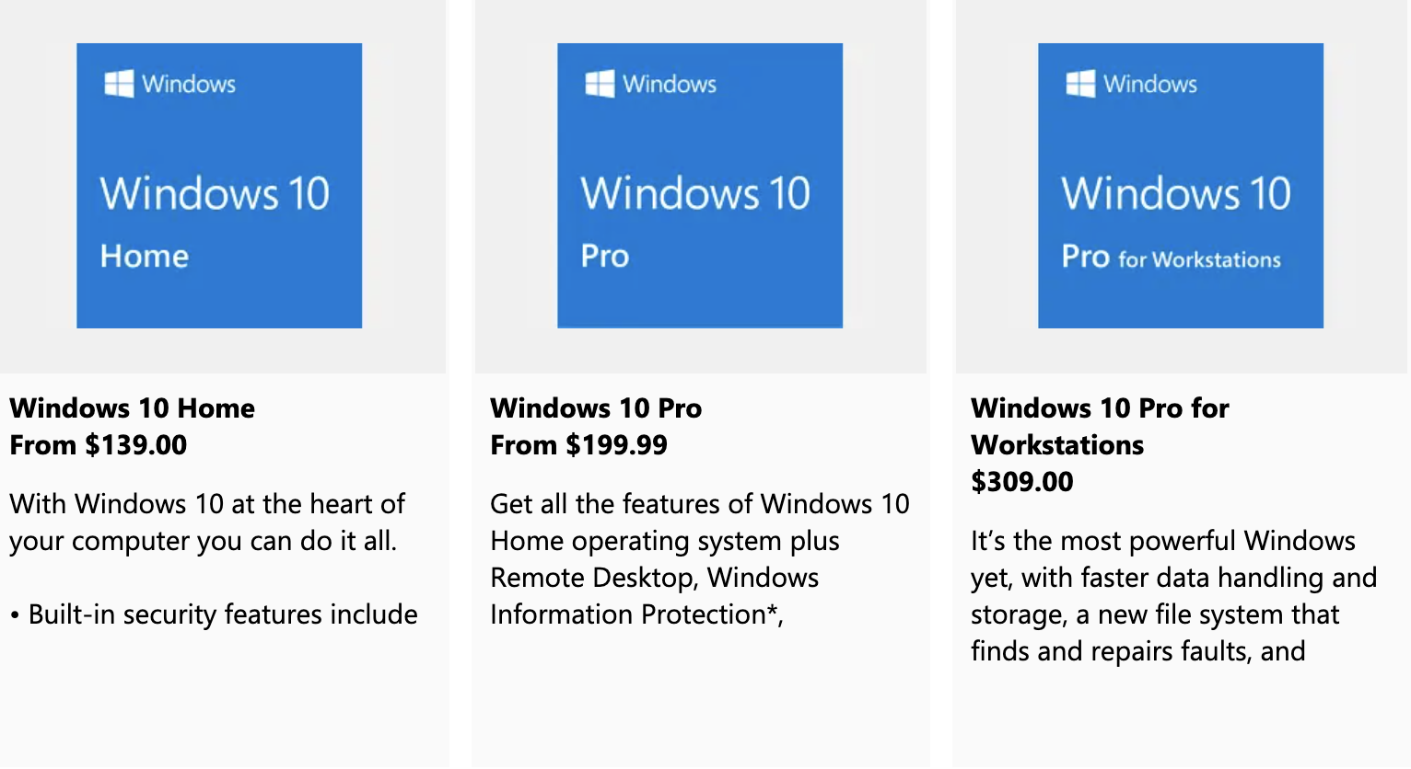
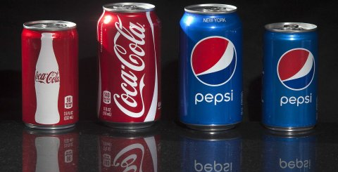
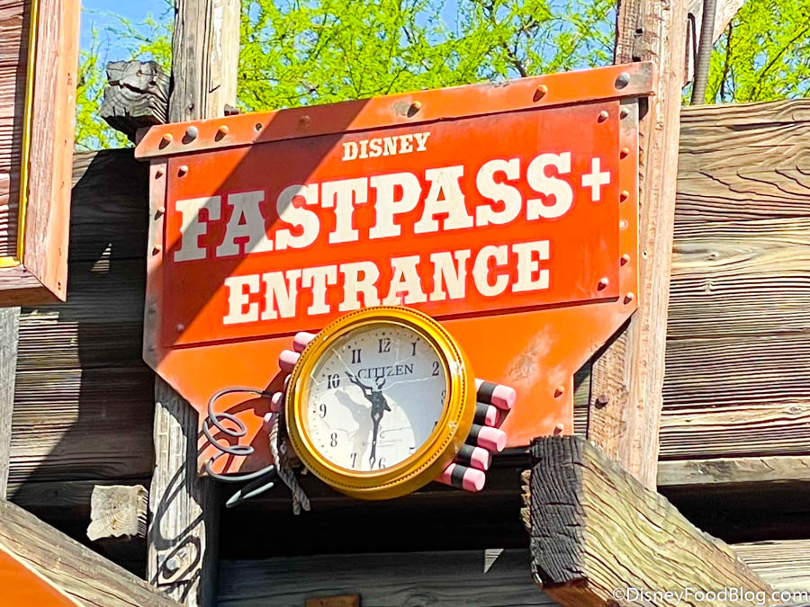
VErsioning
Offer a product line and let users sort themselves
Notes:
An example of Second Degree Price Discrimination: Versioning
We will go in greater depth into one form of second degree price discrimination which is versioning. Versioning is incentive compatible and accomplishes everything that price discrimination accomplishes. Consumers who buy at a high price do so willingly. The key to understand this is that the version priced at a premium has to have features that generate some value to the consumer, but the cost differential to the company is minor relative to the price differential (otherwise there is no real discrimination on price if the surplus captured is the same across segments).
The perfect example is Microsoft: offers Windows Professional and Windows Home Edition. Windows Pro has more features than Home edition but they are otherwise close substitutes. The marginal cost of producing each is identical (and approximately zero) – in fact it may cost the company something to actually differentiate the products. Sometimes it costs nothing to make something better but you don’t want to do it: why doesn’t Microsoft offer the full version of Windows to all their customers since the MC of doing so is zero? Because they would then join the markets, and forego the benefits of price discrimination. You add features to the price insensitive segment so you can charge them more.

Slide 35
Versioning: AMC

Slide 36
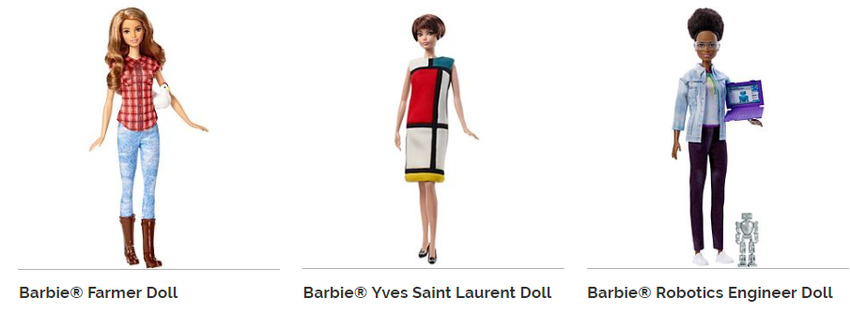



Versioning: Barbie

Slide 37
More Examples for Versioning
Internet service: higher speed at a higher price
Fedex/UPS: ground vs. same-day delivery
Airlines: Business / premium economy / economy
Important note on versioning: Keep low-quality option inferior enough to prevent premium customers from being tempted
  This ensures “incentive-compatibility”
  So you don’t need to worry about resales

Slide 38
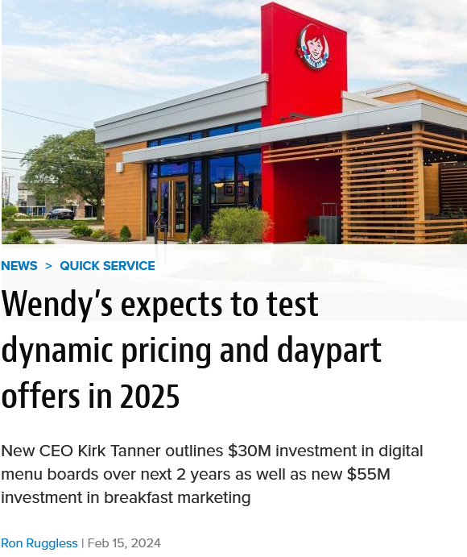
Wendy’s Failed Attempt at Dynamic Pricing
Created immediate consumer backlash and PR disaster: “charge higher prices when consumers are hungry”
Wendy’s issued a correction: Now planning to introduce versioning (offer different menu options and discounts)
Shows that direct price discrimination creates more backlash than indirect price discrimination
Notes:
The tsunami lapped the foundations of the halls of Congress Wednesday when Sen. Elizabeth Warren, D-Mass., issued from her official U.S. Senate X/Twitter account:
“Wendy’s is planning to try out ‘surge pricing’ — that means you could pay more for your lunch, even if the cost to Wendy’s stays exactly the same. It’s price gouging plain and simple, and American families have had enough.”

Slide 39
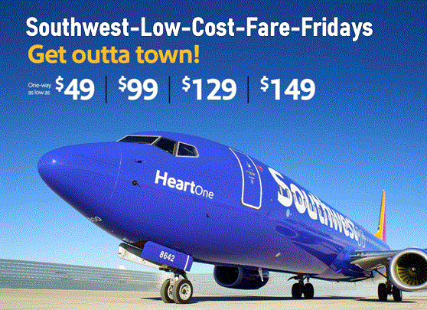
Airline Response to low-Cost Carriers
How should United respond to Southwest starting to offer flights on one of its routes?
Poll Everywhere Break

Slide 40
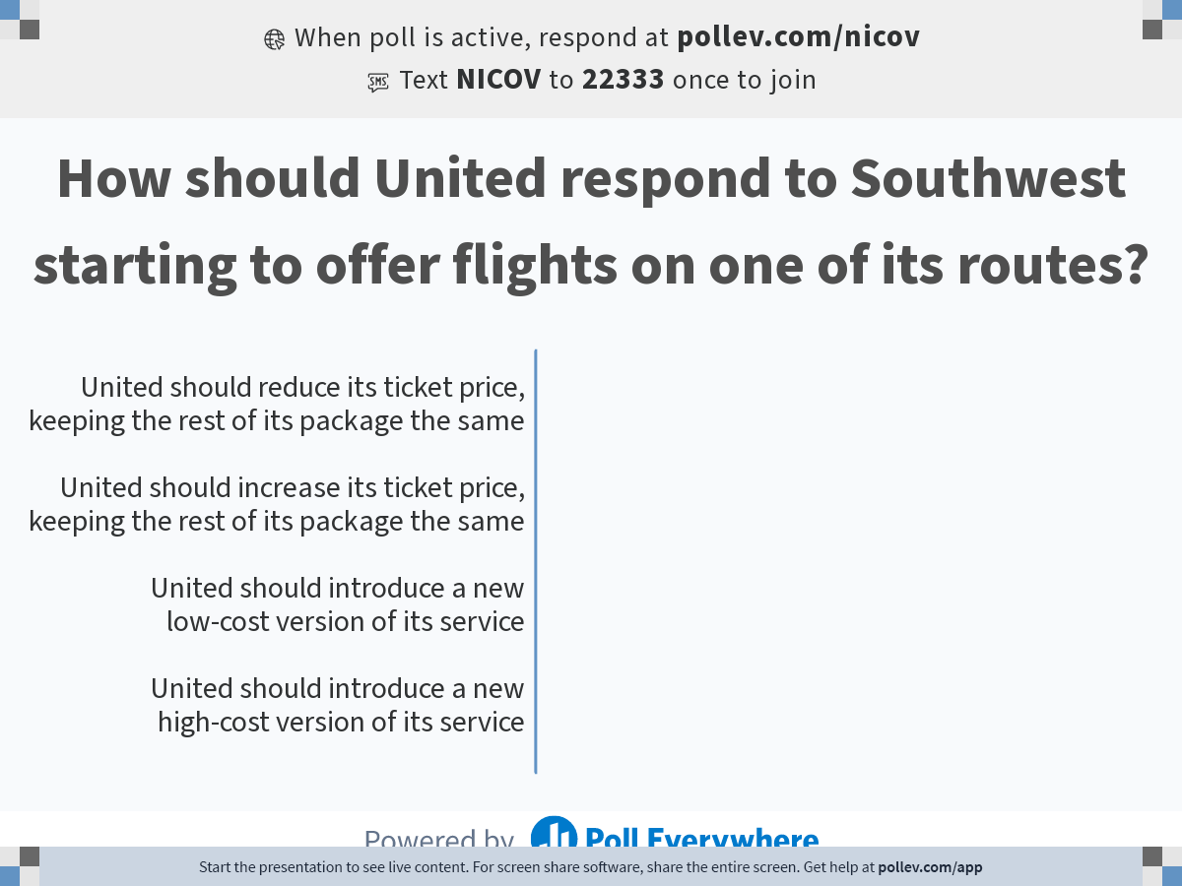
Notes:
Poll Title: Do not modify the notes in this section to avoid tampering with the Poll Everywhere activity.
More info at polleverywhere.com/support
How should United respond to Southwest starting to offer flights on one of its routes?
https://www.polleverywhere.com/multiple_choice_polls/kTjbo3Qwc1lQNUuHpIZ8D?state=opened&flow=Default&onscreen=persist

Slide 41

Versioning in Response to Low-Price Competition
Response by major US airlines to low-cost carriers (Southwest, Spirit):
  No “free” carry-on bag
  No advance seat assignments
  Don’t collect miles…
Compete with low-cost competitors by offering a low-cost / low-quality version of your own product
Not a new strategy. E.g.: Kodak Gold vs. FunFilm in the 1990s
More seating versions…
Notes:
Another Example: Fun Film sold at Price Costco. This is a classic example. Kodak was selling their premium Royal Gold film. Fuji and others started competing. Kodak wanted to protect the low end of their market. They could have lowered the price on Royal Gold, but then you give up capturing the surplus at the high end. So they introduced a new brand, FunFilm, offered only at discount stores like Sam’s Club, Costco, in bulk. This is where price sensitive customers go. It turns out the two films were chemically identical. The packaging and bulk sales aspect were different but the actual product was the same. This is a classic B-school case.

Slide 42
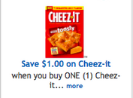
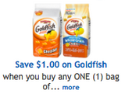
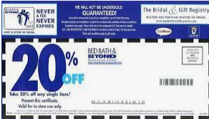
Second-Degree price Discrimination: coupons
Coupons ensure incentive-compatibility
Notes:
Checkout stand coupons: Nobody wants to spend money unnecessarily, but it takes time to sort through the coupons. Those who have nothing else to do on a Sunday morning, i.e. those with a low opportunity cost of time, who are price sensitive, will take the time to cut the coupons. This is an ingenious scheme to charge higher price to the low elasticity customers to capture more consumer surplus.

Slide 43
OUTLINE of module 6
Simple vs. complex pricing
Direct price discrimination
  Perfect price discrimination (first degree)
  Segment pricing (third degree)
Indirect price discrimination (second degree)
    Versioning
  Coupons
Advanced pricing strategies
  Flat fee pricing
  Two-part tariff
  Block pricing

Slide 44
Context
So far: We had different consumers with different demand curves (marginal personal value)
  Extract surplus via direct/indirect price discrimination
Now: Consumers have identical demand curves, but each of them purchases multiple units of the product
  We will focus on a “representative consumer”

Slide 45
Advanced Pricing
How to extract consumer surplus from a given consumer who is prepared to buy multiple units
Diminishing marginal personal value comes into play
We will study three variants of advanced pricing
  All-or-none offers (flat fee)
  Two-part tariffs (flat fee + usage fee)
  Block pricing

Slide 46
Example: Netflix flat fee (assume MC=0)
P
Yellow area = total value of unlimited movies for the consumer = maximum fee Netflix can charge
Area = (16x2)/2 = 16
With a $16 flat flee for unlimited access, Netflix can attain $16 revenue – twice as much as under simple pricing (see Module 6 – Video 1)
The consumer will watch 16 movies under this fixed-fee-unlimited-access system
Consumer surplus in this case = 0
Note: only makes sense when MC=0
$2
P=2-Q/8
Revenues
=$16
D
16
Movies
Notes:
With MC=0, people buy to where the value is zero. You want to capture the entire area under the demand curve. How much does the consumer pay? For a flat fee of $400, he would be just willing to purchase the bundle of 20 units. The company doubles their contribution and extracts all the surplus.
Equivalent pricing schemes: A sliding scale discount pricing scheme amounts to the same thing – charge lower and lower amounts for each subsequent unit sold. Here you march the consumer down the demand curve and you charge successively lower prices that allow you to capture all the surplus. The quantity discounts come from the seller’s realization that the buyer has a downward sloping demand curve.

Slide 47
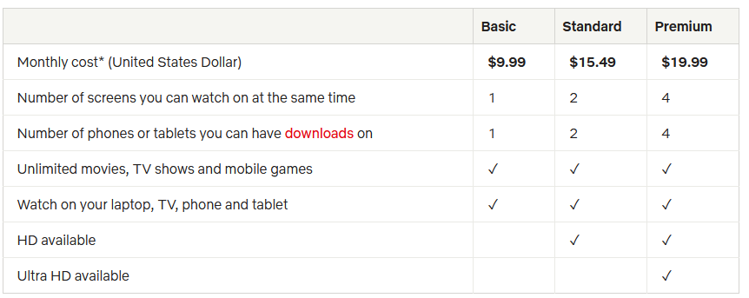
Netflix pricing strategy
  Note that this pricing strategy is a mix of flat fee and versioning
Notes:
This chart represent the pricing strategy of Netflix, as an example of versioning. They have three plans, from basic to premium. The chart on the right represents the change in strategy that Netflix followed over time
This is a very good video on increase in price in 2017, where they also discuss previous price increases and the backlash associated with them
https://finance.yahoo.com/news/netflix-price-hikes-wont-hurt-subscriber-growth-211526185.html

Slide 48
WSJ Article on Netflix
  What’s wrong with the following statement?

Slide 49
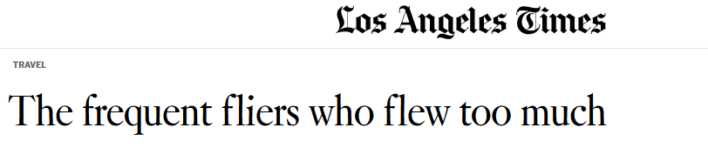
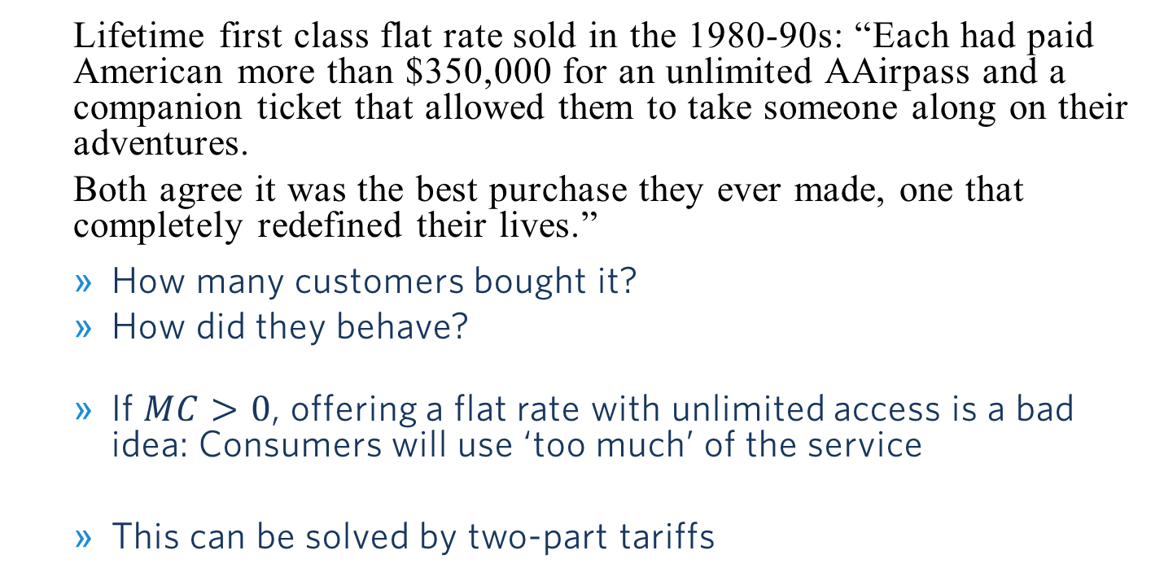
What can Go Wrong with Flat Rates…
  Lifetime first class flat rate sold in the 1980-90s: “Each had paid American more than $350,000 for an unlimited AAirpass and a companion ticket that allowed them to take someone along on their adventures.
  Both agree it was the best purchase they ever made, one that completely redefined their lives.”
  How many customers bought it?
  How did they behave?
  If $MC>0$, offering a flat rate with unlimited access is a bad idea: Consumers will use ‘too much’ of the service
  This can be solved by two-part tariffs
Notes:
Only 65 customers bought the flat rate pass

Slide 50
OUTLINE of module 6
Simple vs. complex pricing
Direct price discrimination
  Perfect price discrimination (first degree)
  Segment pricing (third degree)
Indirect price discrimination (second degree)
    Versioning
  Coupons
Advanced pricing strategies
  Flat fee pricing
  Two-part tariff
  Block pricing

Slide 51
Two part-Tariff
Now: MC>0
P
Flat fee ,F*, is equal to the entire consumer surplus. Usage fee, P*, is set equal to MC.
F*
P*
MC
D
Q

Slide 52
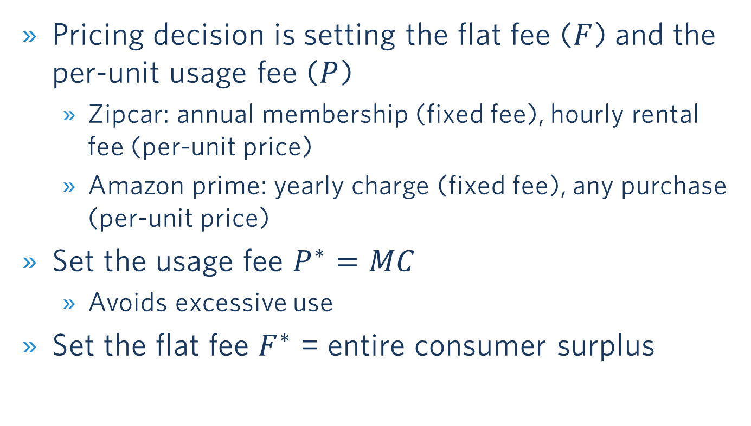
Two-part tariff
Summary
Pricing decision is setting the flat fee ($F$) and the per-unit usage fee ($P$)
  Zipcar: annual membership (fixed fee), hourly rental fee (per-unit price)
  Amazon prime: yearly charge (fixed fee), any purchase (per-unit price)
Set the usage fee $P^{∗}=MC$
  Avoids excessive use
Set the flat fee $F^{∗}$ = entire consumer surplus

Slide 53

Two-Part Tariff: ZipCar
P
Two-part tariff:
  Flat fee: F =$50
  Usage fee: P =$0.5/mile
Would a flat fee without usage fee (P =0) be a good idea?
  No, it would lead to excessive use
$1.50
$$P=1.5−0.01Q$$
Flat fee
=$(1.5-0.5) ∙100/2
=$50
MC
$0.50
Per-mile usage fee
=$0.5∙100 = $50
D
100
150
Q (miles per year)

Slide 54

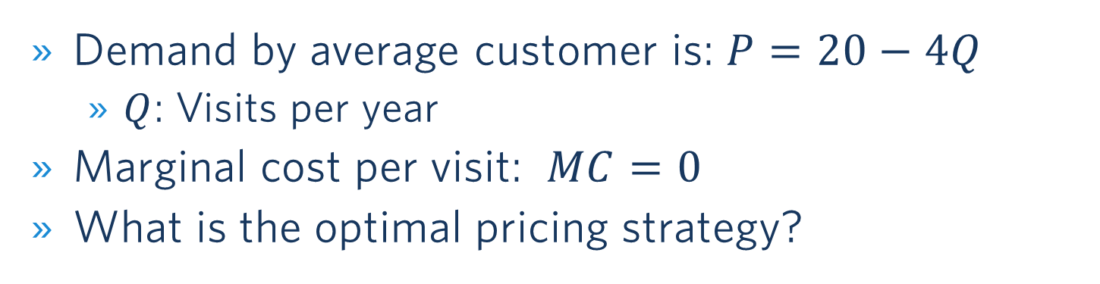
Pricing at a Local Zoo
Demand by average customer is: $P=20−4Q$
  $Q$: Visits per year
Marginal cost per visit: $MC=0$
What is the optimal pricing strategy?
Poll Everywhere Break

Slide 55
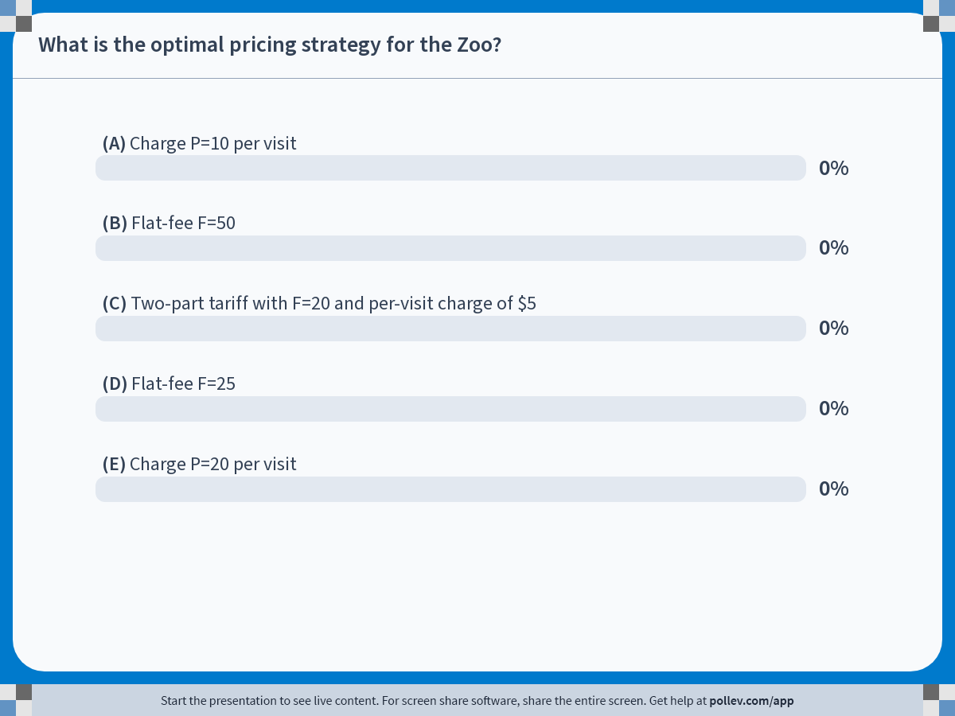
Notes:
Poll Title: Do not modify the notes in this section to avoid tampering with the Poll Everywhere activity.
More info at polleverywhere.com/support
What is the optimal pricing strategy for the Zoo?
https://www.polleverywhere.com/multiple_choice_polls/hmpajEICOBWnni2rKMoIs?state=opened&flow=Default&onscreen=persist

Slide 56
Zoo Pricing – Solution

Slide 57

Zoo Pricing – Flat Fee Pricing
P
Flat-Fee Pricing:
  Flat fee: F =$50
Profit: $50 per customer
(assuming zero fixed cost)
$20
$$P=20−4Q$$
Flat fee
=$20∙5/2
=$50
Overall 5 visits since price paid per visit is zero
D
5
Q (visits per year)

Slide 58

Zoo Pricing – Comparison to Simple Pricing
P
Simple Pricing:
  Profit: $25 per customer (assuming zero fixed cost)
$$P=20−4Q$$
$$⇒MR=20−8Q$$
$$MR=MC=0$$
$$⇒Q^{∗}=2.5;P^{∗}=10$$
$20
$10
Note: For Two-Part Tariff, see Problem Set 5, Problem 2
Under simple
Pricing:
$25
MC=0
D
MR
5
2.5
Q (visits per year)

Slide 59
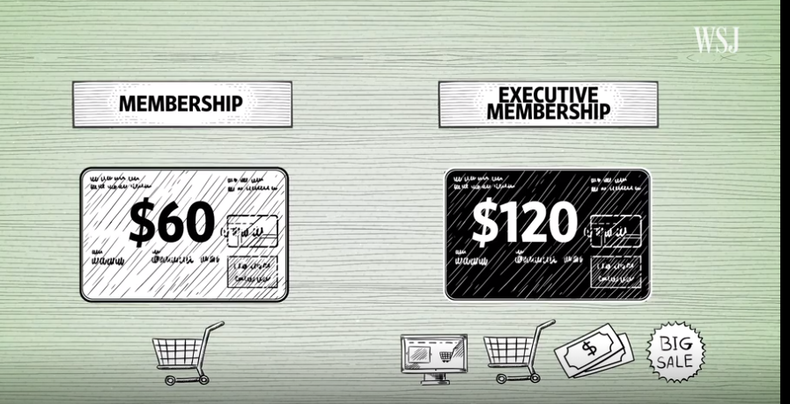
CostcO: Combination of Versioning and Two-Part Pricing
Business model
  Make money on the memberships
  Sell goods at the cheapest price possible
  WSJ video on the strategic layout of Costco stores

Slide 60
OUTLINE of module 6
Simple vs. complex pricing
Direct price discrimination
  Perfect price discrimination (first degree)
  Segment pricing (third degree)
Indirect price discrimination (second degree)
    Versioning
  Coupons
Advanced pricing strategies
  Flat fee pricing
  Two-part tariff
  Block pricing

Slide 61
Block Pricing
Block pricing is the practice of reducing the price of a good when the same customer buys more of it

Slide 62
Block pricing: Photo cards at walmart
Price ($/photo card)
Marginal cost of printing photo cards: MC =$0.05
Assume zero fixed costs
The first option is 100 cards at $0.25
  Profits are A (since TFC =0)
Sell additional 25 cards at $0.20 ($5 extra for 25 cards)
  Additional profits B
Sell yet additional 50 cards at $0.10 ($5 extra for 50 cards)
  Additional profits C
Three purchase options:
100 cards at $25
125 cards at $30
175 cards at $35
$0.25
$0.20
A
B
$0.10
$0.05
C
MC
D
100
125
175
Q (photo cards)
Notes:
Note that the pricing strategy can be also be expressed as 100 at $25, 125 at $30, 175 at 35$. Consumers will opt to purchase 175 at $35 and Walmart will still increase its producer surplus

Slide 63
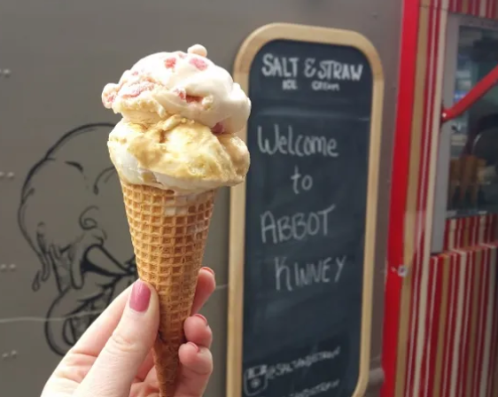
Block pricing: Ice Cream
Price ($/scoop)
Purchase options:
1 scoop for $4
2 scoops for $7
3 scoops for $8.50
$4.00
Price of the 2nd scoop is $7-$4=$3
$3.00
A
B
$1.50
C
MC
$1.00
D
1
2
3
Q (scoops per customer)

Slide 64
How to extract consumer surplus?
A summary of pricing strategies
Does the firm have market power?
Perfect competition produces quantity at which MR = P = MC
No
Yes
Can the firm prevent resale and arbitrage?
No
Firm produces quantity (Q*) at which MR = MC, sets price P* where Q* = D(P*)
Yes
Advanced pricing strategies
• Flat-fee
• Two-part tariff
• Block pricing
Do the firm's customers have different demand curves?
No
Yes
Can the firm directly identify different customers?
Indirect (second-degree) price discrimination
• Versioning
• Coupons
Direct price discrimination
Yes
No
Firm has complete information about every customer
-----------------------------------------
Perfect (first-degree) price discrimination
Firm has information on groups of customers
-----------------------------------------
Segmenting (third-degree) price discrimination
Source: Goolsbee, Levitt, Syverson

Slide 65
Some Examples for Innovative Pricing Strategies

Slide 66
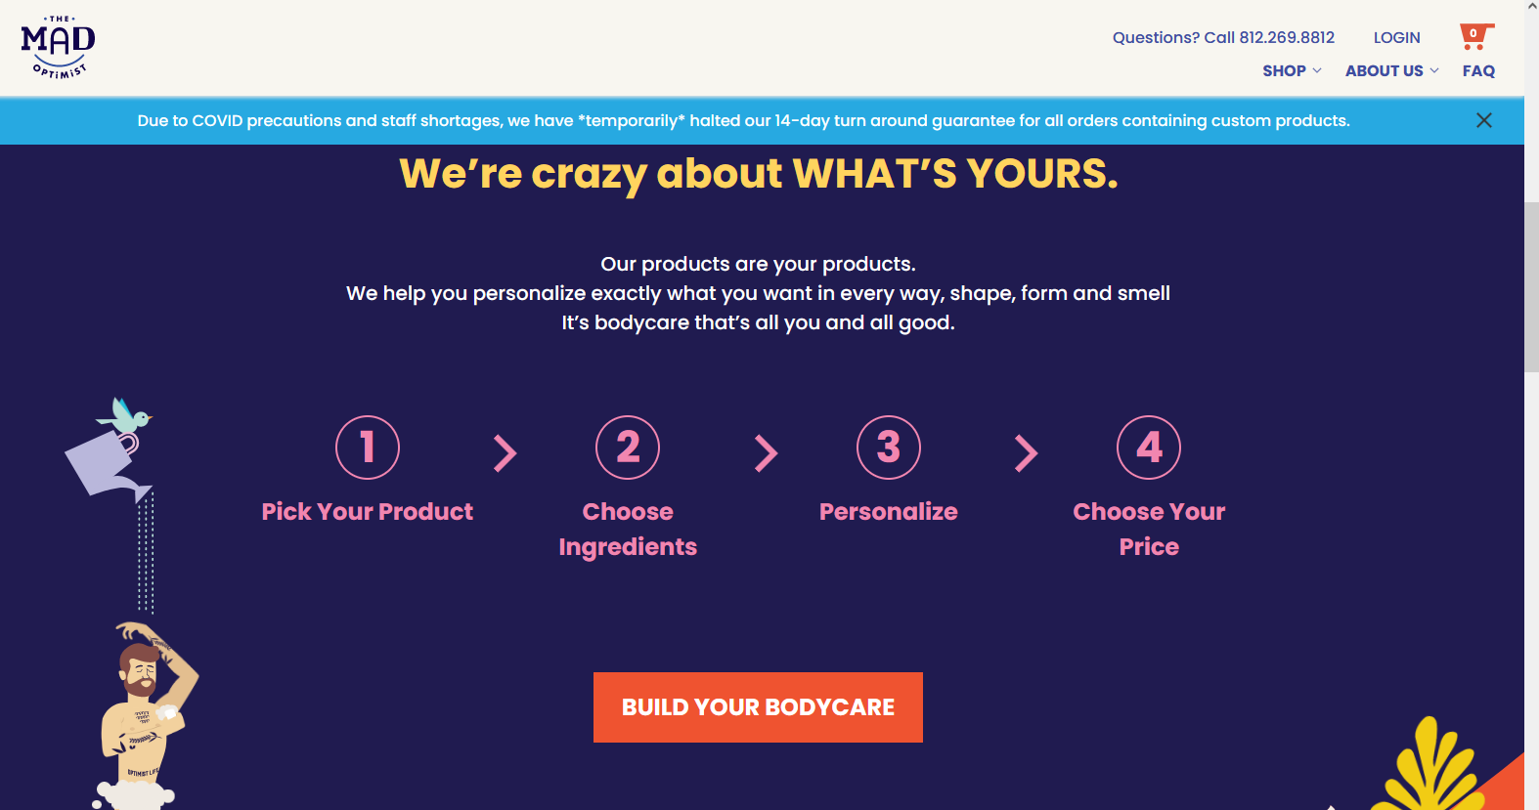
The mad optimist
An interesting way to extract consumer surplus
Notes:
Attempts to extract consumer surplus

Slide 67
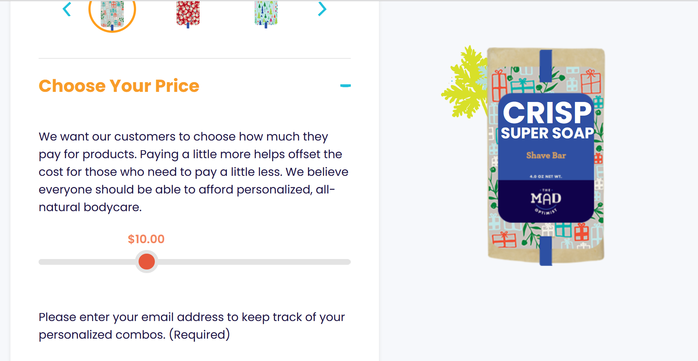
The mad optimist – “Choose your Price”
Notes:
Attempts to extract consumer surplus

Slide 68
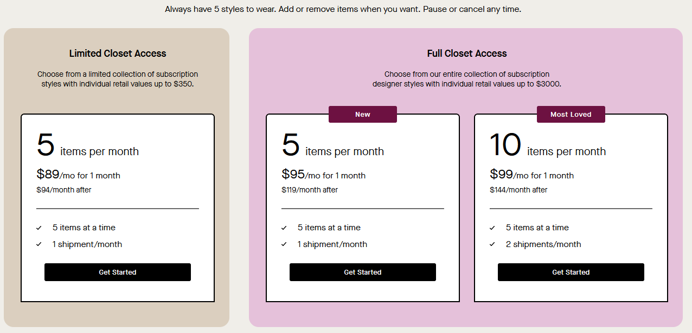
Rent the runway
Combination of block pricing and versioning
Notes:
Combination of block pricing and versioning

Slide 69
The mad optimist
An interesting way to extract consumer surplus
Notes:
Attempts to extract consumer surplus

Slide 70
The mad optimist – “Choose your Price”
Notes:
Attempts to extract consumer surplus

Slide 71
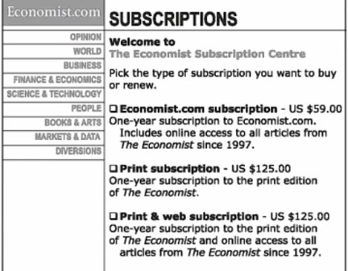
The economist pricing example
What do you think about this pricing strategy?
→ 16%
→ 84%
Customer attention focused on the comparison between the two $125 options
Notes:
The experiment was as follows,
- In one case consumers saw two options at 125 one including only print and one including print and web, and one at $59.
- In the other treatment consumer were given two options: $59 and $125 for print and web.
When people saw the three options 84% of them chose print and web and only 16% the cheapest option. Their attention went to the comparison between the two options at 125.
In the experiment with two options only 32% of them chose the expensive option, most of the (68% chose the $59 option)
Explanation: https://cxl.com/blog/pricing-experiments-you-might-not-know-but-can-learn-from/

Slide 72
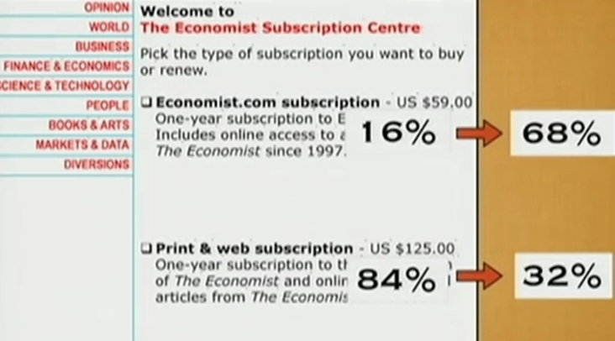
Dan Ariely’s experiment
Customer attention drawn to the comparison between $59 and $125
Notes:
Explanation: https://cxl.com/blog/pricing-experiments-you-might-not-know-but-can-learn-from/

Slide 73
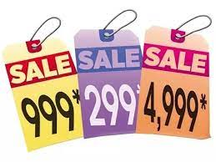
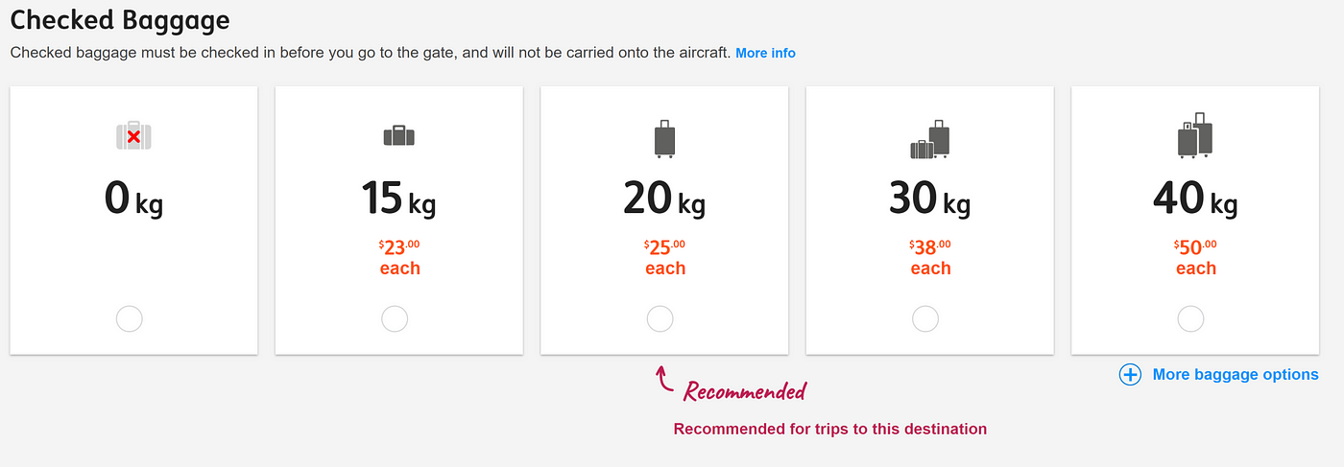
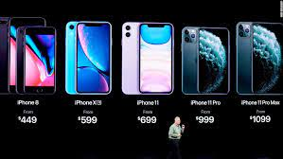
Behavioral insight:
Price Framing
Adding highly priced option draws attention to intermediate prices
Prices ending in 9 or .99 draw focus to the previous digit.
Notes:
Price framing is the optimization of how to present prices, services, and products in the most appealing way. It's not changing the prices of your products or services but the way they are exhibited in order to encourage consumers to make more purchases.

Slide 74
Module 6 summary
Limitations of simple pricing
Direct price discrimination
  Personalized pricing (first degree). (Still) hypothetical.
  Segment pricing (third degree)
    Higher price to less elastic groups
Indirect price discrimination
  Versioning and coupons (second degree)
Advanced pricing strategies:
  If MC=0: Flat fee and unlimited access (e.g., Netflix)
  If MC>0: Two-part tariff (flat fee + usage fee)
    Usage fee = MC to avoid excessive use
    Flat fee = area under the demand curve above the per-unit fee
  Block pricing

Slide 75
Backup

Slide 76
